Slide 1
Image Processing

Slide 2
Introduction
Digital Image Processing Techniques
will be carried out using an FPGA based design on RTL level. Pixel operation will be performed using combinational circuit. There are some restrictions in hardware, limited memory capacity and less accurate interfacing hardware as we will show later.

Slide 3


Edge detection!
Our aim is to design a chip capable of detecting the edges of an image.

Slide 4
Implementation Steps
1
Let’s start with the first set of Instructions

Slide 5
Specify the algorithms which will be used to achieve the required specifications.

Slide 6
Design the digital design architecture for the algorithms.

Slide 7
Write the hardware description language (Verilog) code of the filter.

Slide 8
Handle the interfaces of the filter with the video input from the camera, and the video output to the screen via VGA protocol.

Slide 9
Make a prototype on the FPGA kits

Slide 10
Applications
Edge detection techniques are using for many applications as the following.

Slide 11
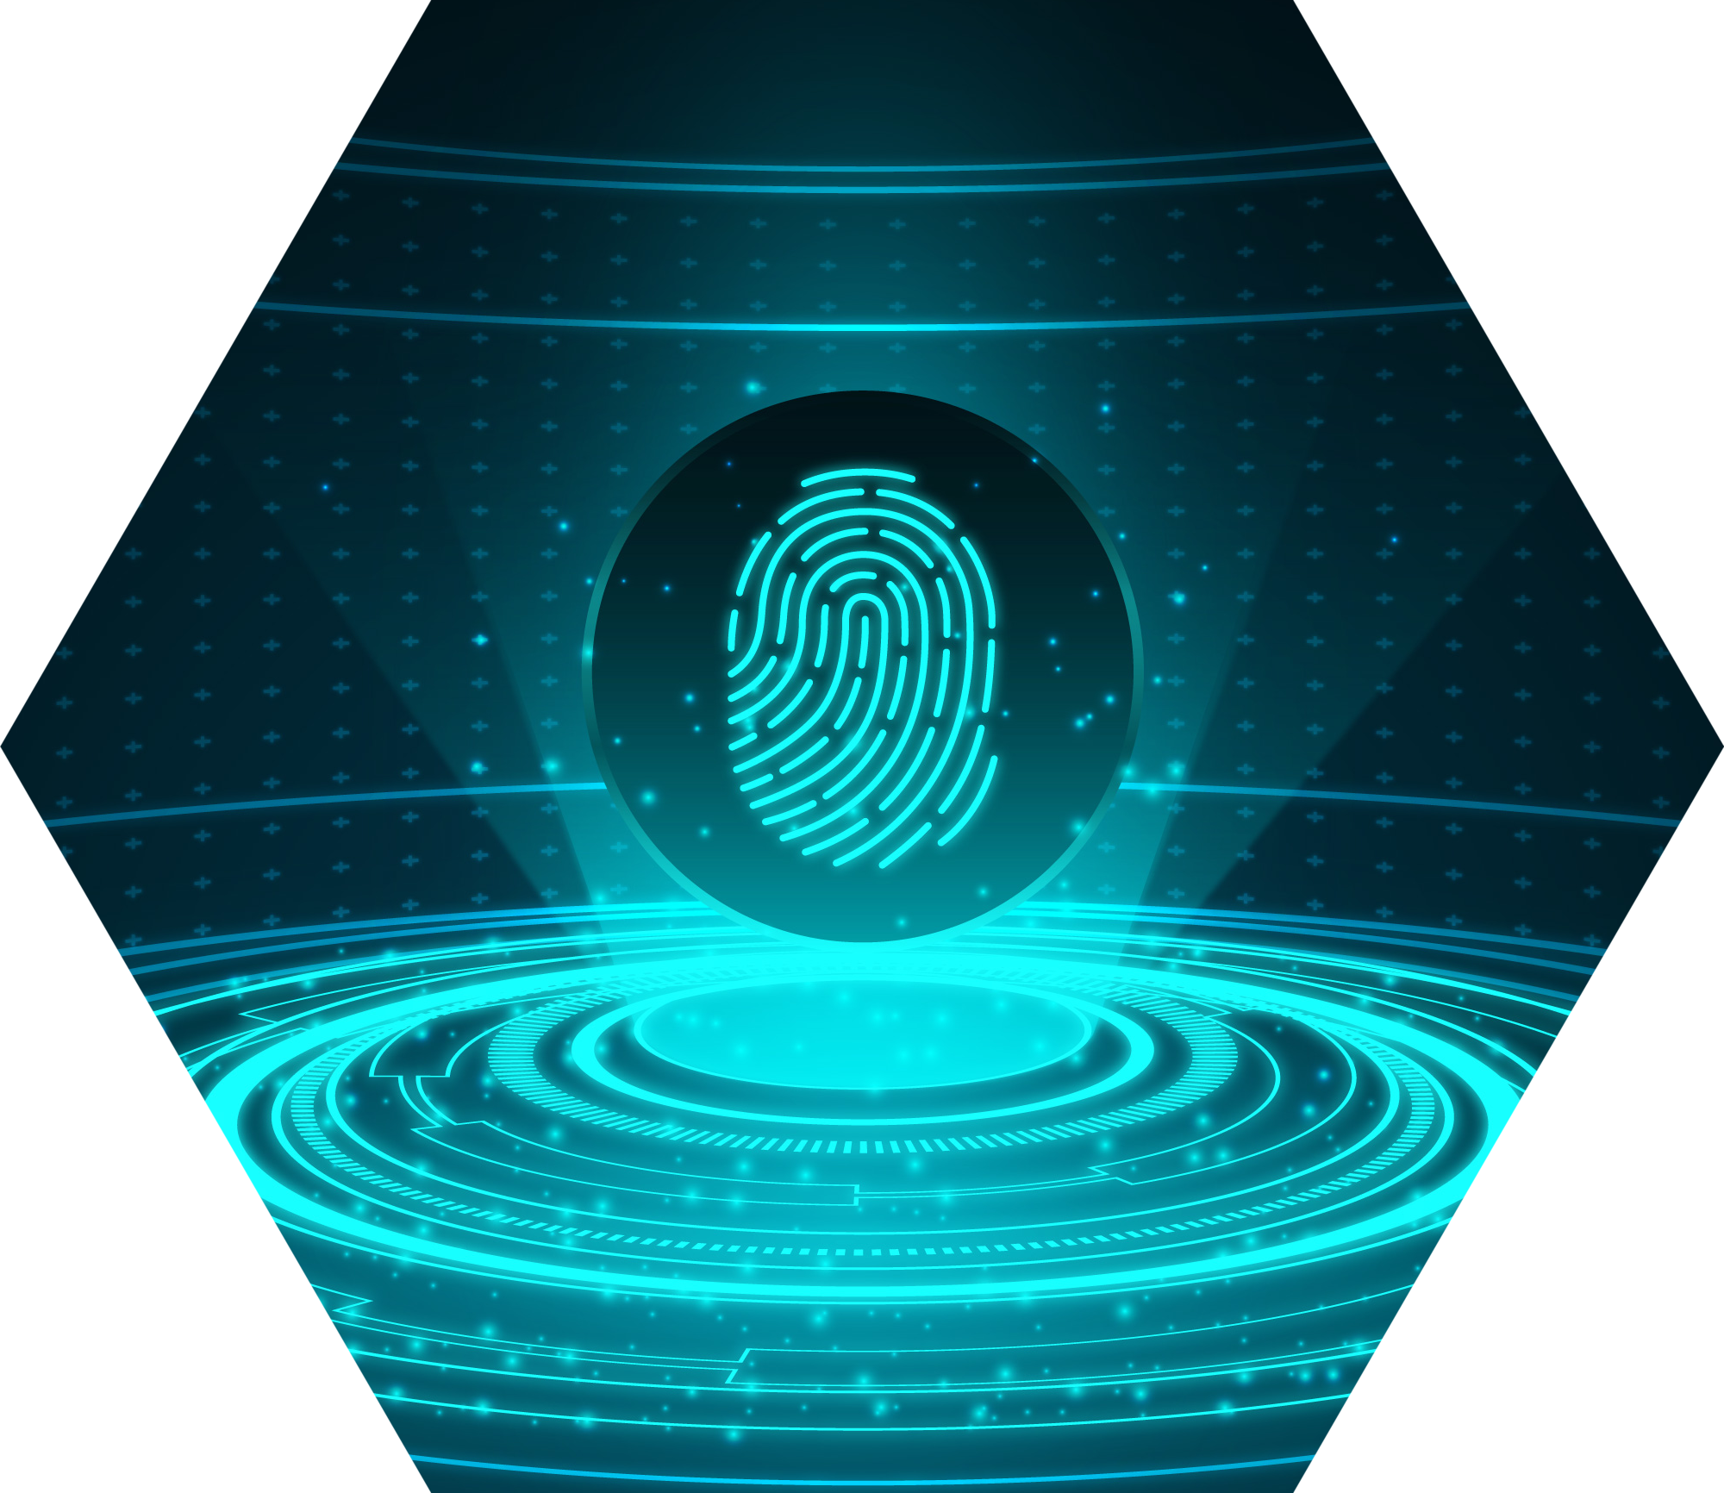
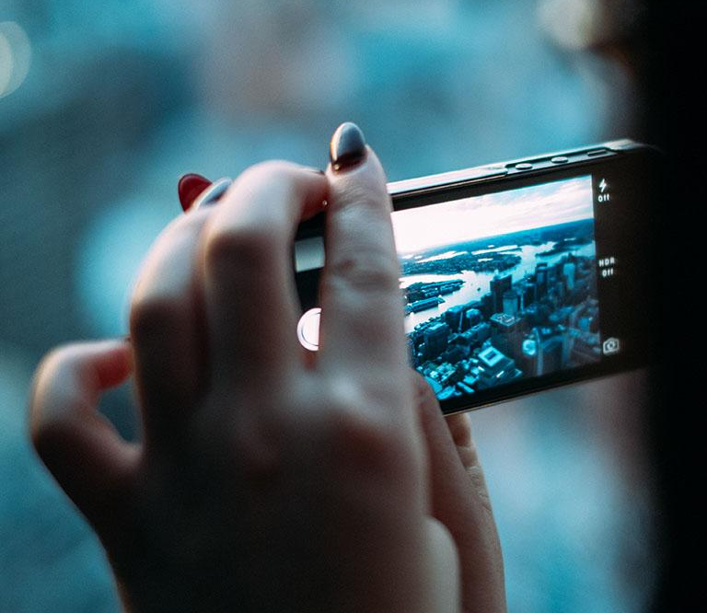
Finger Print
At present finger print recognition has been used widely such as in mobile phones.
Edge detection techniques enhance the quality of image and cause the improvement in the image recognition.

Slide 13
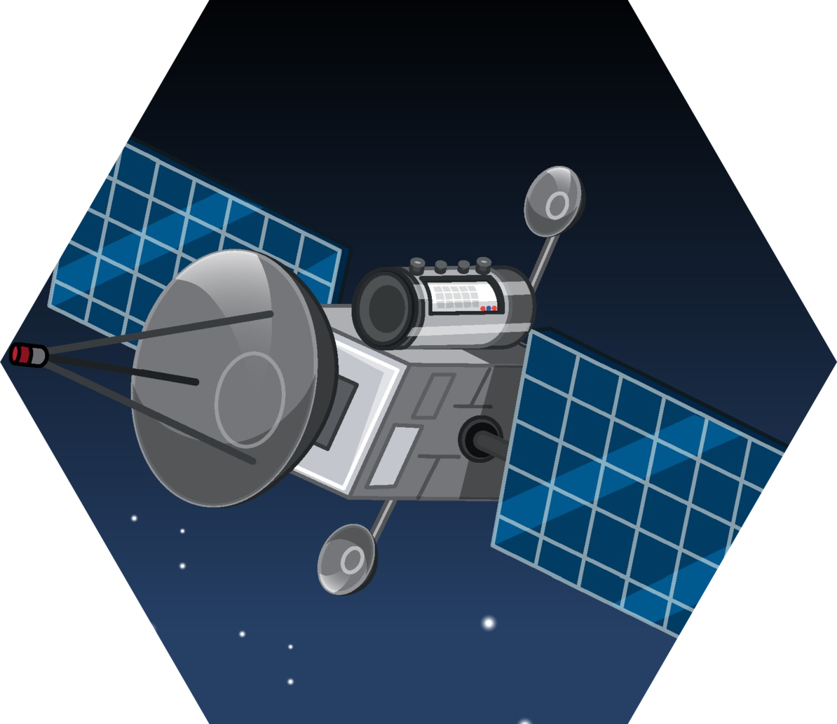
Satellite Image
The edge map generated by bilateral filtering-based edge detection contain more accurate and well localized edge map.
It also suppresses noise and produces more realistic edge map.

Slide 14
Original Satellite Scan
from Sobel operator

Slide 15
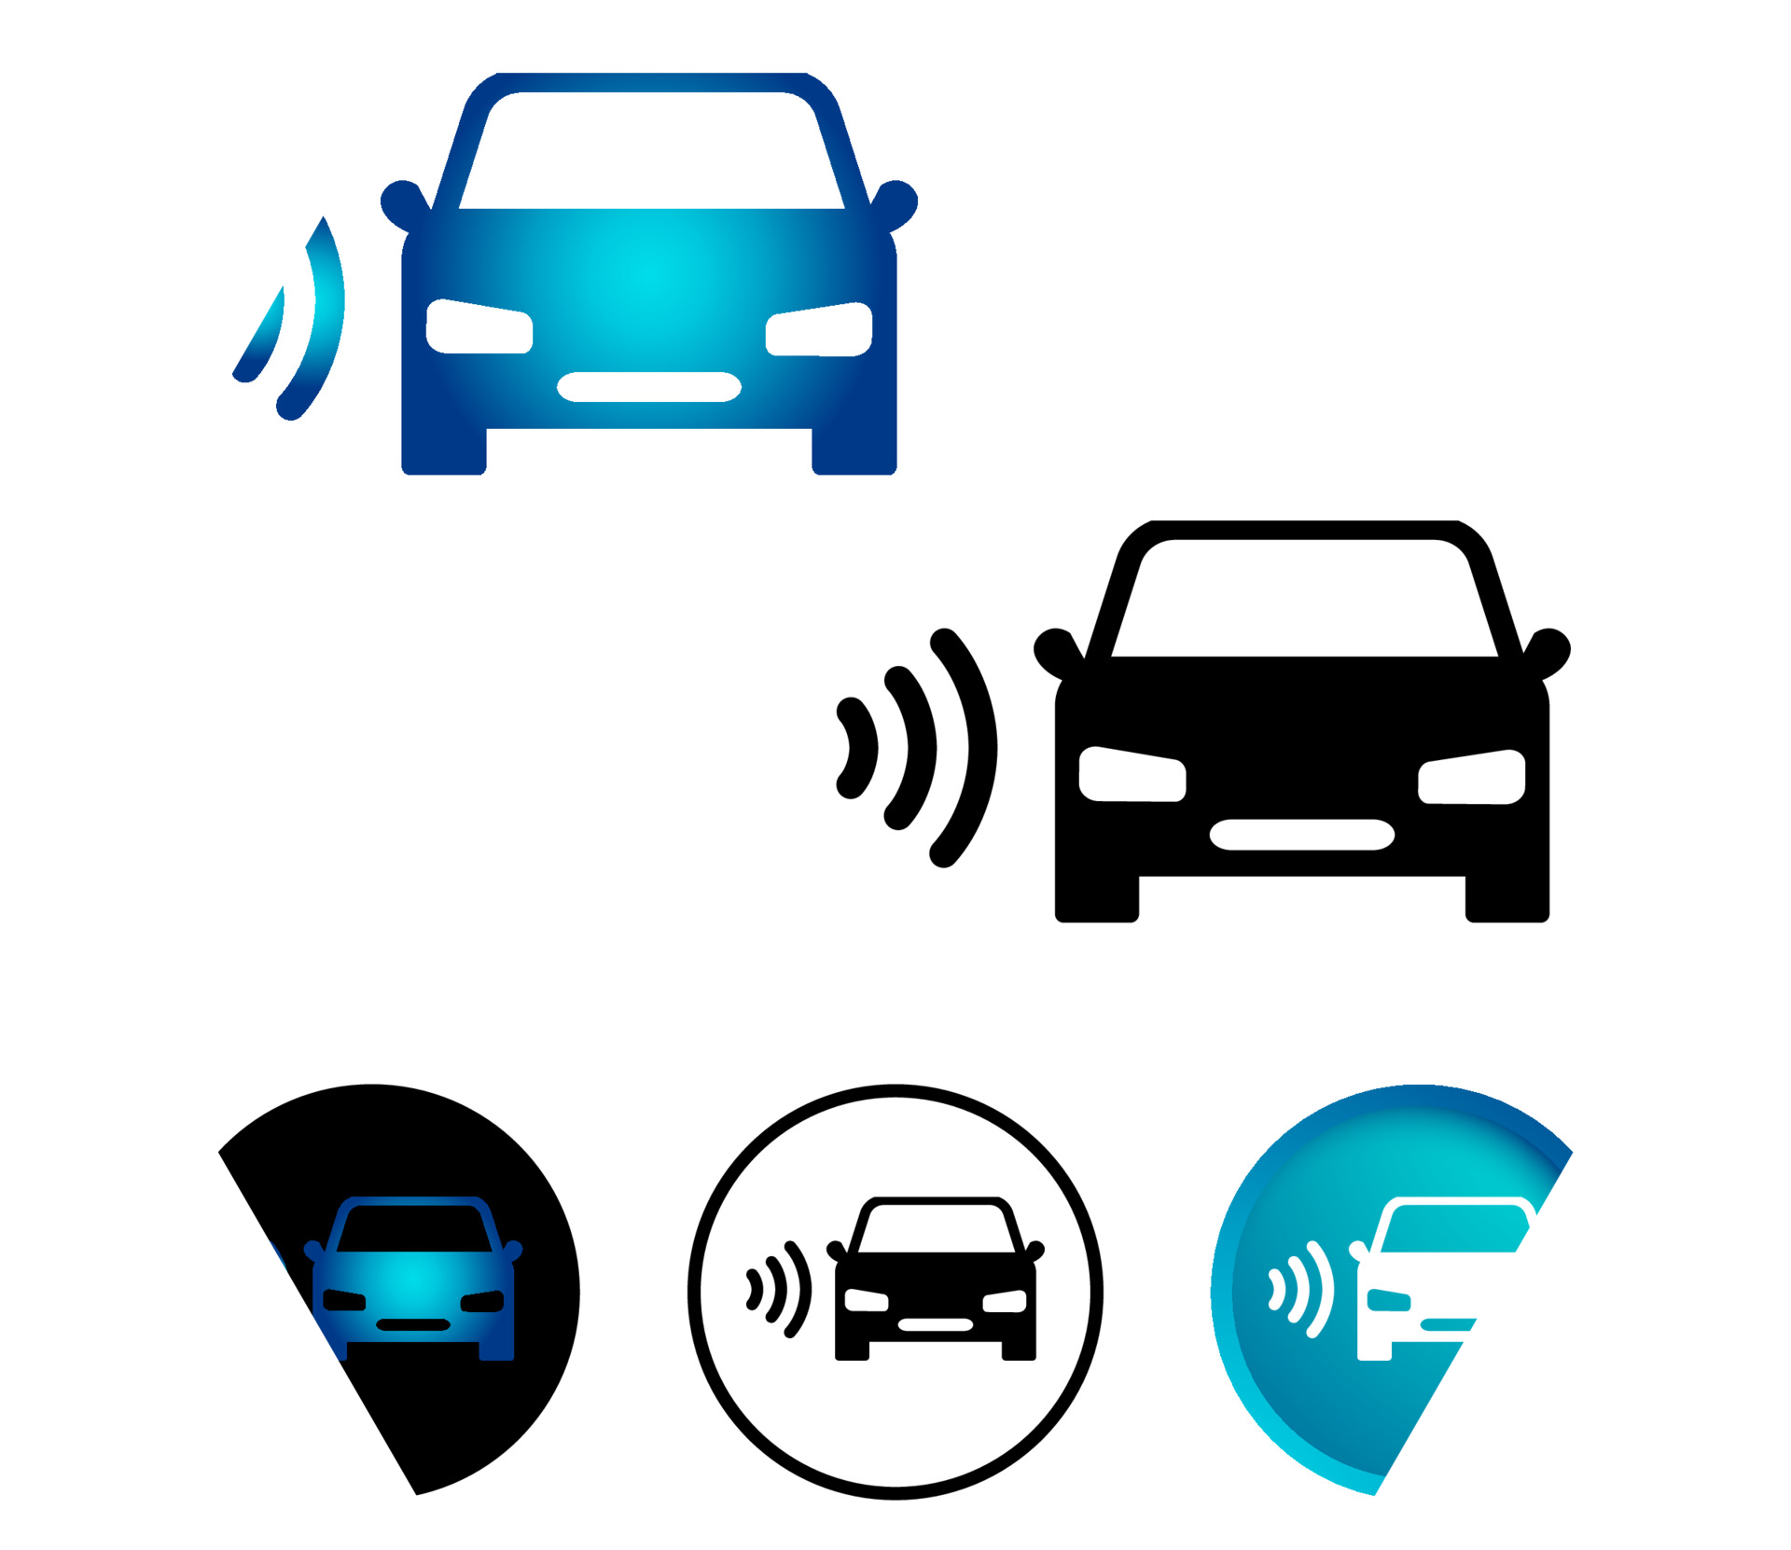
Robotics vision
The present and near future main application areas of edge detection (ED) are robotics vision (e.g. in self-driving vehicles).
Set the steering wheel angle based on picture of road.

Slide 16
Original Robotics Scan
from Sobel operator
Detected car

Slide 17
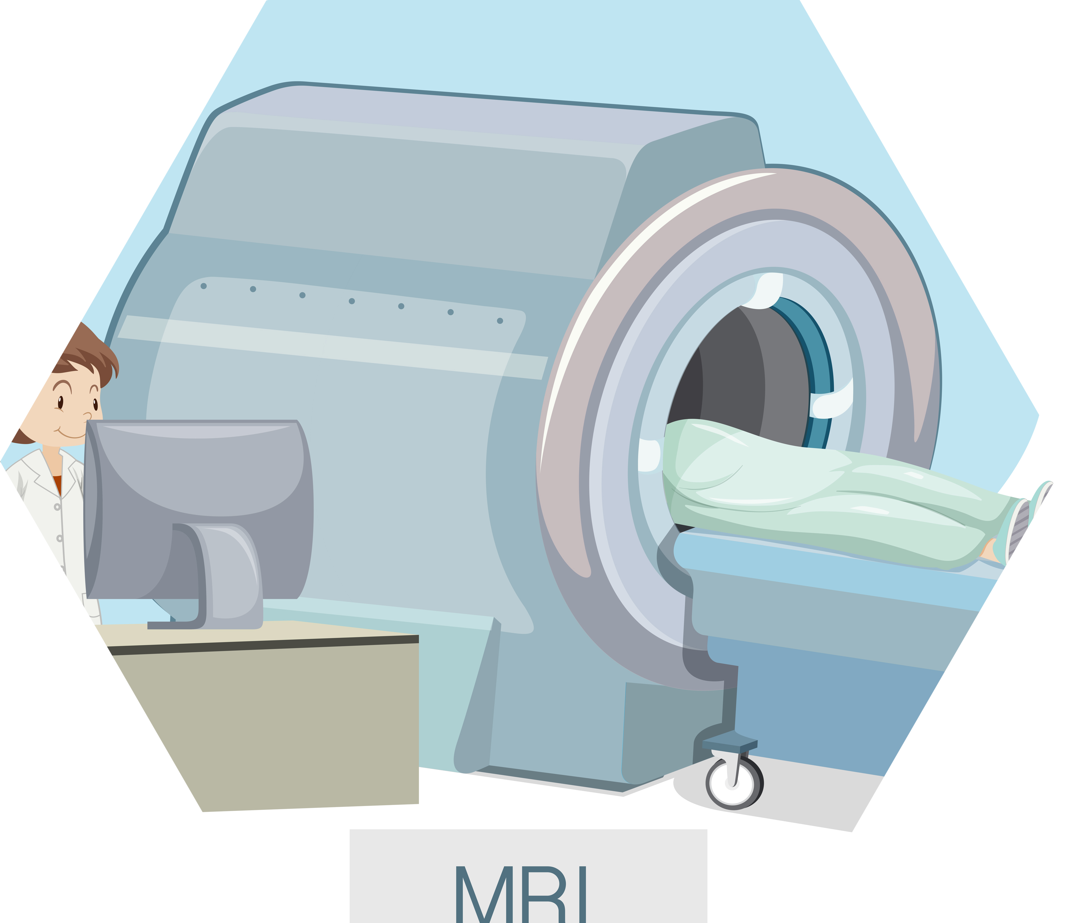
Medical science
Another important area being developed which of course involves edge detection is finding “pathological” objects in medical images such as tumors.
Medical image edge detection is an important method in the recognition of the human organs and it is an important pre-processing step in 3D reconstruction such as the reconstruction of brain images.

Slide 18
Original MRI Scan
from Sobel operator
from Canny operator

Slide 19
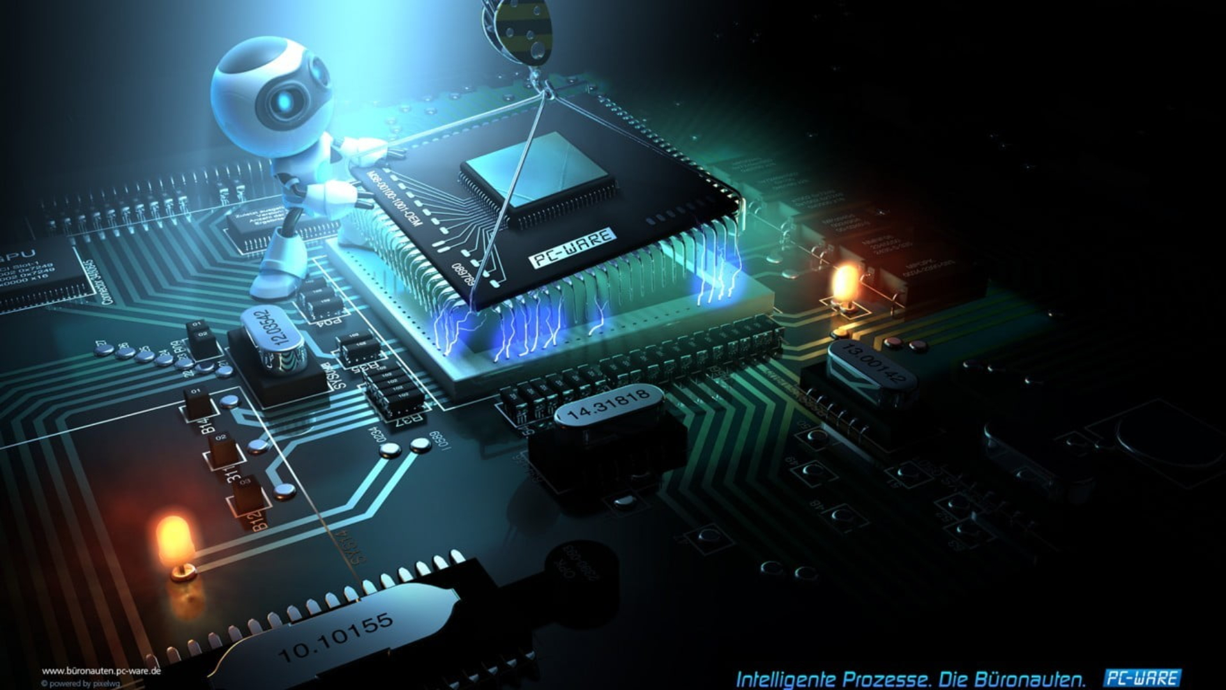
Why design a chip?
We chose a chip design instead of Embedded systems or any software.

Slide 20
Chip design features
Less energy consumption
Faster
Cheaper

Slide 21
Proposed Architecture
2
Let’s see our Chip diagram

Slide 23
Main modules
3
Let’s see our modules to use in the project

Slide 24
Camera
We will use this module to take the picture which will be processed.

Slide 25
FPGA kit
The ZYBO kit is suggested as it’s available in Egypt, in addition to the reasonable price for an FPGA kit which has VGA port.

Slide 26
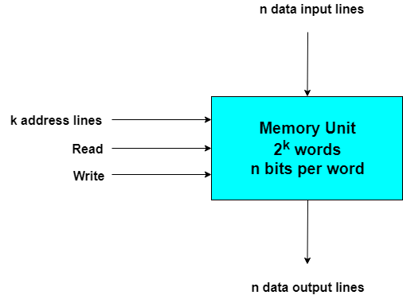
Memory
As we introduced previously in the block diagram, we will have two memories for input and output [filtered] images in case of disabling the pipeline. If we supported the pipeline in our design, then we will need to double the two memories and swap between them, which will increase the block RAM accordingly.

Slide 27
Challenges
Memory Area:
If we worked in the normal case using 640*480 resolution of the frames coming from the camera, and each pixel contains data of 8-bit = 1 Byte, then we will need 307.2 KB for each memory.
Timing:
For Sobel filter for example, we will need 10 clock cycles as the following: 9 clock cycles to read 3*3 matrix pixels from the input memory, and one clock cycle to write the constructed pixel.
Pipeline:
As we mentioned previously in the Memory area, using pipeline should double the block RAM, and the power will be increased as a result of the increased area and the three block will work continuously in parallel, but it will reduce the processing time surely.
FPGA availability:
The FPGA cost may be high and expensive, especially if we search for another kit which contains much block RAM to handle 640*480 resolution in pipeline behavior. For example, Virtex-7 has an extra block RAMs and costs $6,245 [about 98k EGP].

Slide 28
Phases
Edge Detection: Sobel Filter, Pewit, Robert, Grayscale2Binary.
Adding Color Correction, RGB2YUV, Gamma Correction
Adding 2D FIR Filter, Median Filter.
1
2
3

Slide 29
Thanks!
Any questions?

Slide 30
References:
1. Apps of edge detection: https://www.slideshare.net/NareshBiloniya/application-of-edge-detection-96942725
2. Verilog tutorial: https://www.asic-world.com/verilog/veritut.html
3. VGA protocol: https://onlinelibrary.wiley.com/doi/book/10.1002/9780470374283 (CHAPTER 13), by PONG p. CHU
4. Camera datasheet:
https://datasheetspdf.com/pdf-file/555220/OmniVisionTechnologies/OV7670/1
5. Noise réduction: https://www.ijsr.net/archive/v6i3/25031706.pdf
Kits datasheet:
https://www.tindie.com/products/lesthersk/zybo-zynq-7000-armfpga-soc-trainer-board/
https://www.xilinx.com/products/boards-and-kits/dk-v7-vc709-g.html#hardware

Slide 31
Team Presentation
Mohamed Emam
Belal Sameh
Ibrahim Hossam

